Slide 1
ICU Survival
Dr. David Yamane
Leah Gustafson Ista, PGY4

Slide 2
PGY1
Enhance your knowledge base
Gather and interpret data
Focus on pt presentations and assessments
PGY2
Procedures and medications
Focus on treatment plan
PGY3
Management and teaching
Learn from the fellow

Slide 3
The basics (gwicu.com)

Slide 4
The Future (blogs.gwu.edu/Leahgus)

Slide 5
Nurses
They are here to help!
Know the ICU
Have valuable information
Can bail you out of tough situations

Slide 6
Nursing Do’s:
Introduce yourself and your role
Ask questions
Keep them in the loop of treatment plans, orders, medications.
Ask them their thoughts on pt care

Slide 7
Nursing Don’ts:
Don’t blow off nursing concerns!
Don’t be overly confident. If you don’t know, they are happy to help.
Don’t rely on the nurse to do your assessment.

Slide 8
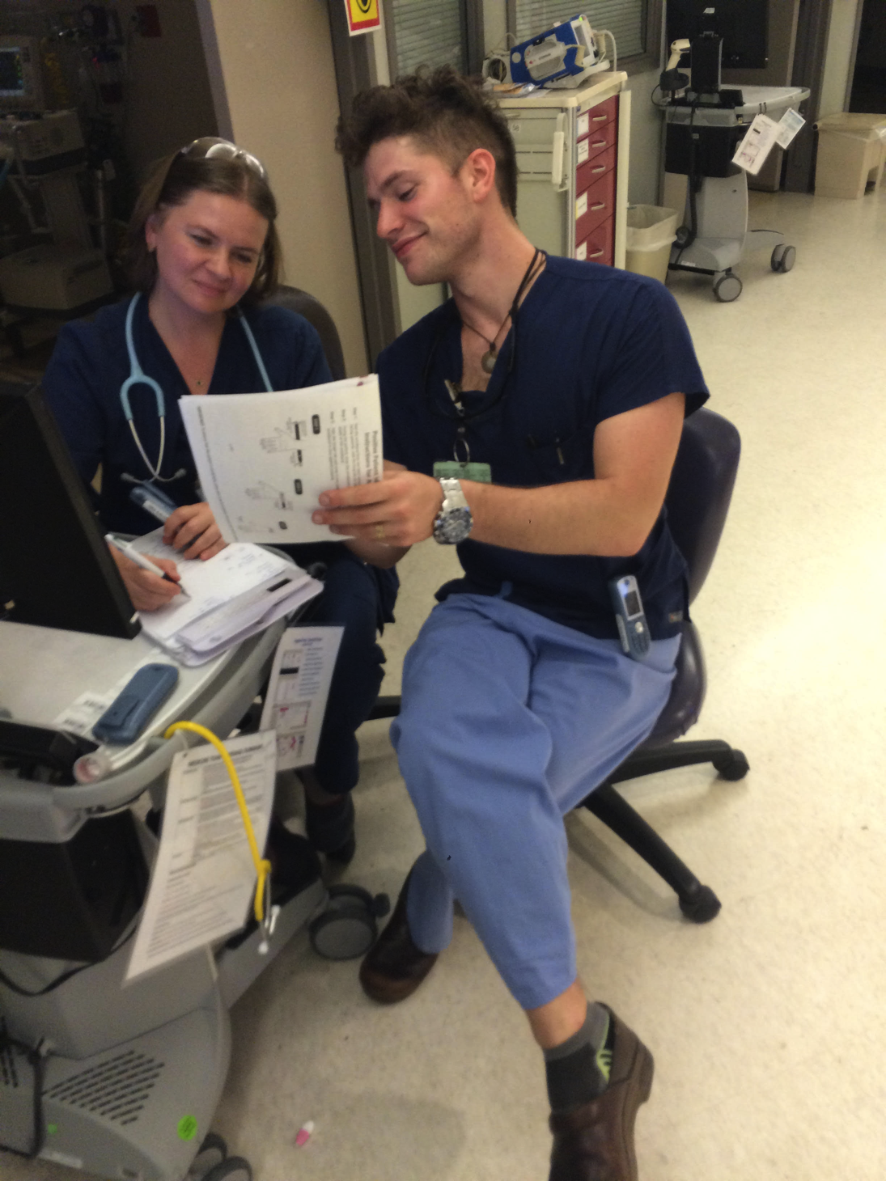
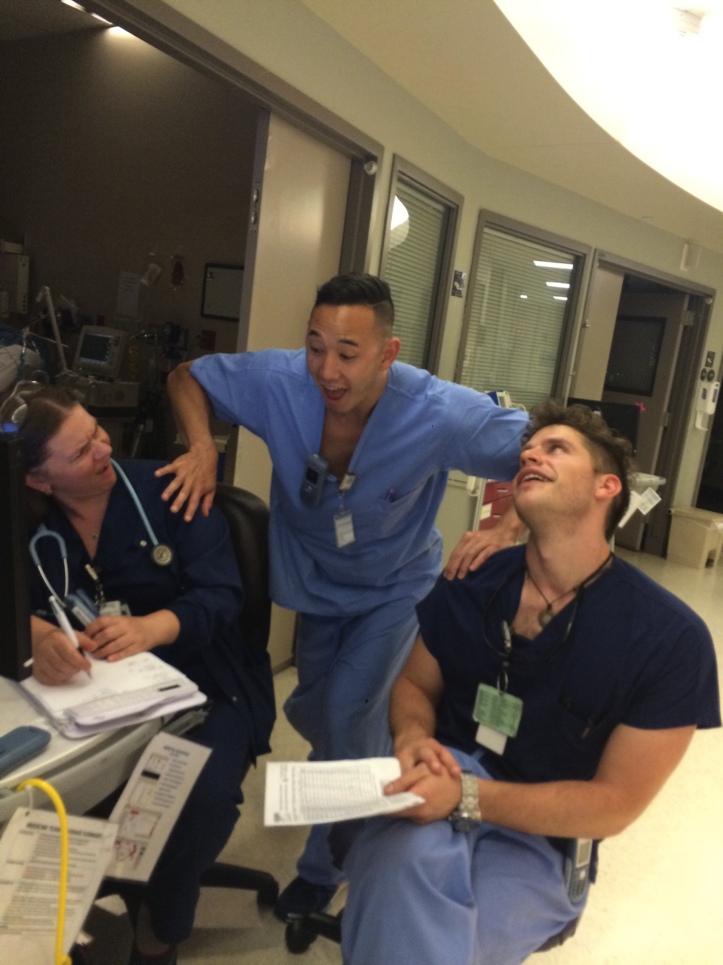
Nursing Sign-Out: 7-7:30am
Do not to interrupt, except for emergent issues.
If you want to talk to the night nurse, get there early.

Slide 9
Pre-rounds
ICU Pt Presentation Outline
ICU Pt Template
Both available on blogs.gwu.edu/Leahgus

Slide 10
Pre-Rounds: Chart Checking

Slide 11
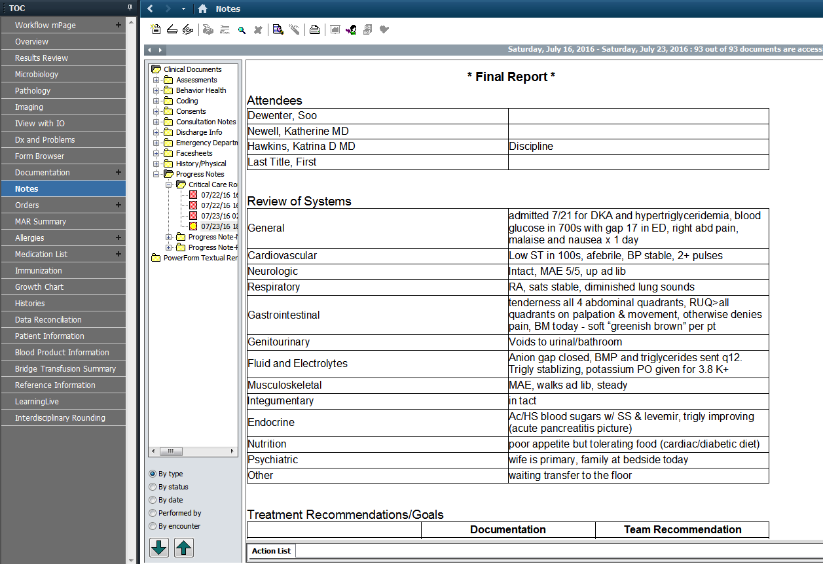
Pre-rounds
“Notes” section:
“Critical Care Rounding”
Provides a daily, systems based review of what is going on with the patient

Slide 12
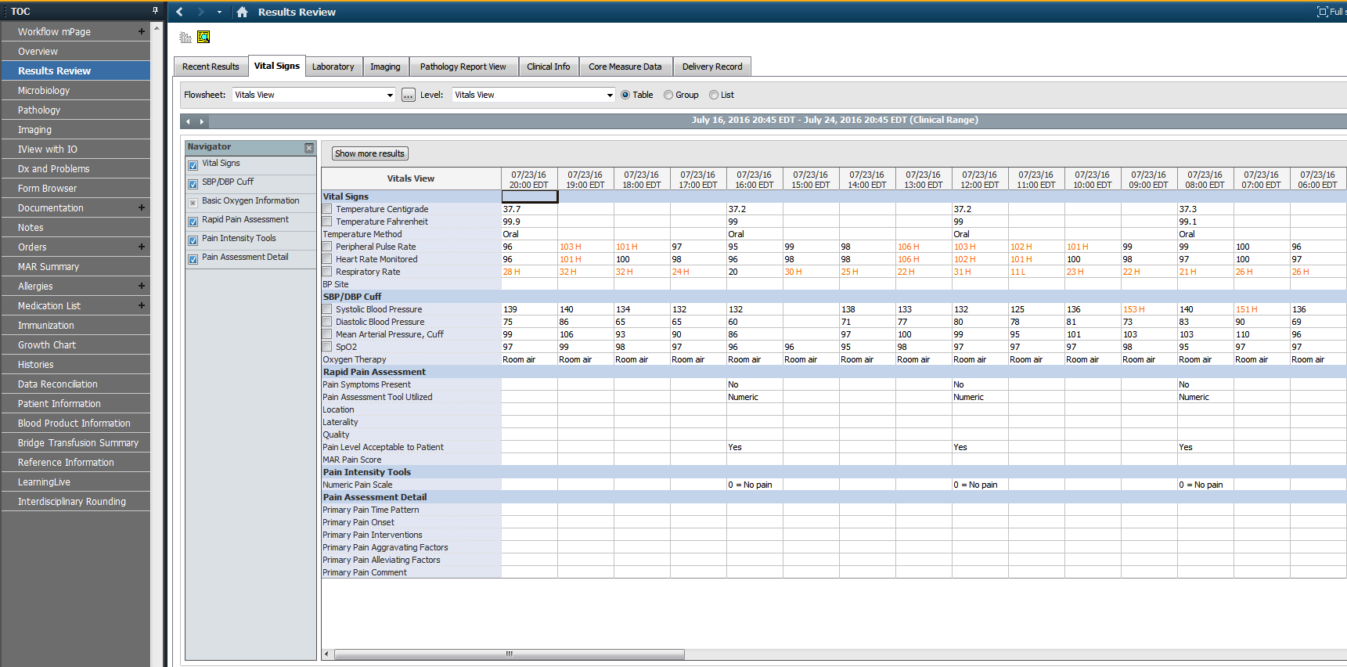
Pre-rounds
Results Review section
Vital signs tab

Slide 13
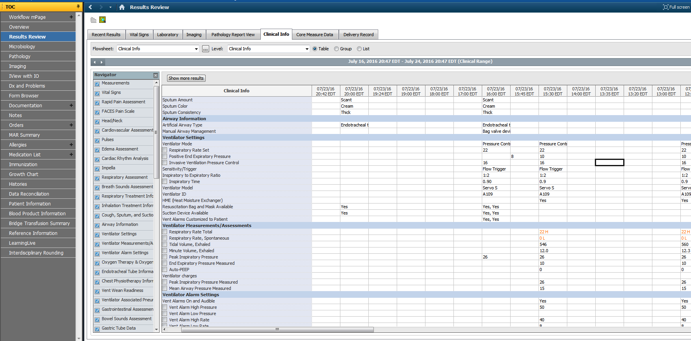
Pre-rounds
“Results Review” Section
Clinical info tab
Ventilator setting information
Do NOT rely on this

Slide 14
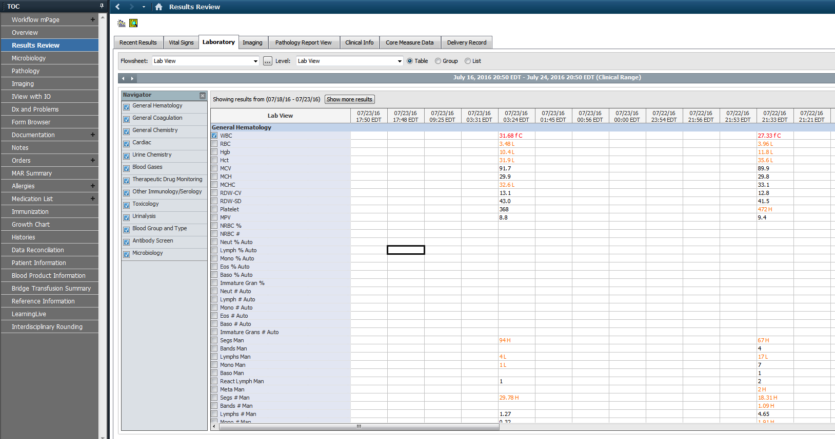
Pre-rounds
“Results Review” section
Labs tab
Make note of trends and abnormal values

Slide 15
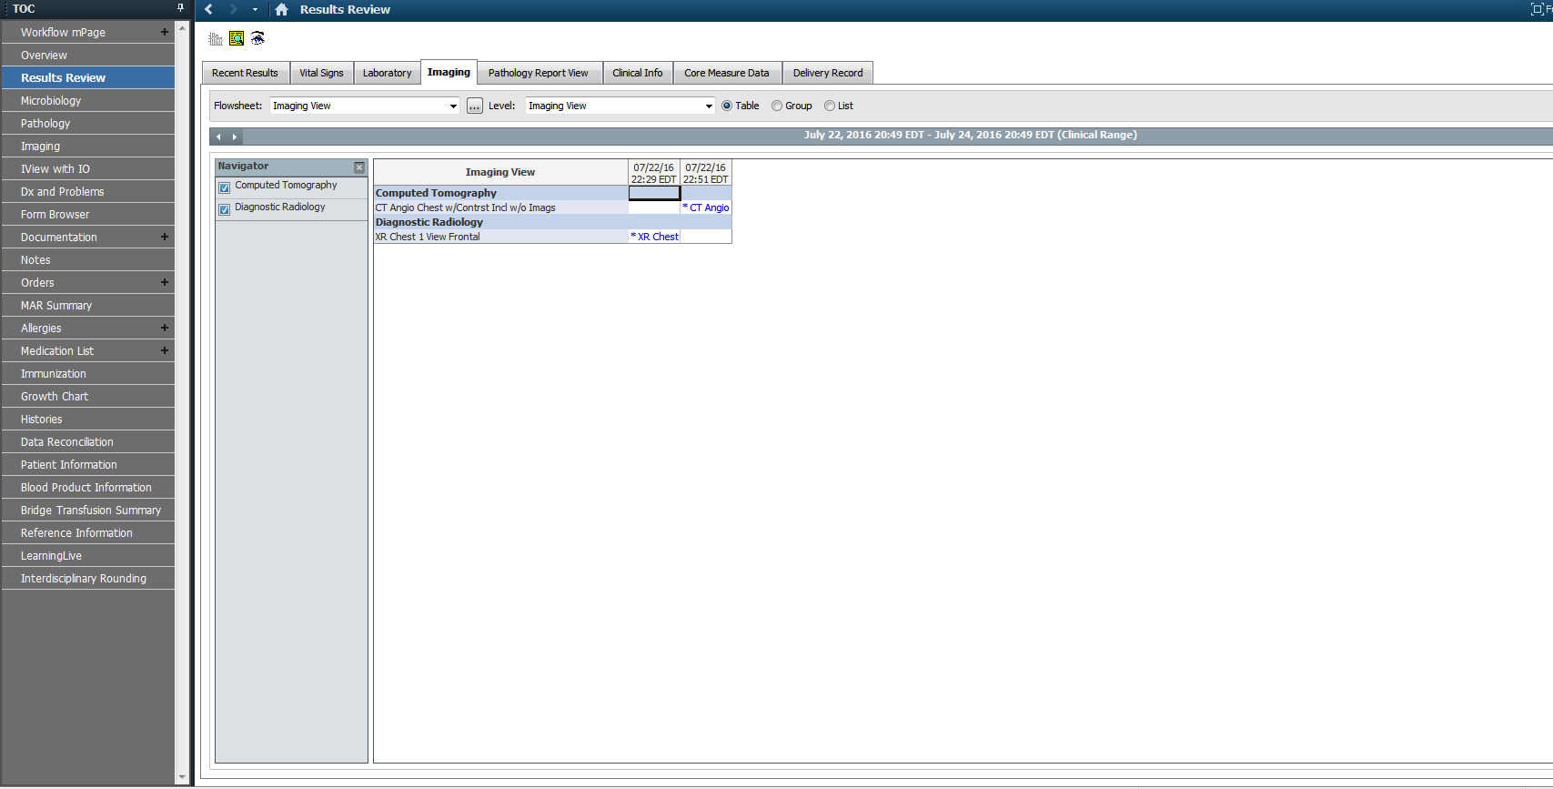
Pre-rounds
Results Review section
“Imaging” tab
Review all new imaging
Look at all studies yourself
Compare to previous
Confirm ETT and line placement every time

Slide 16
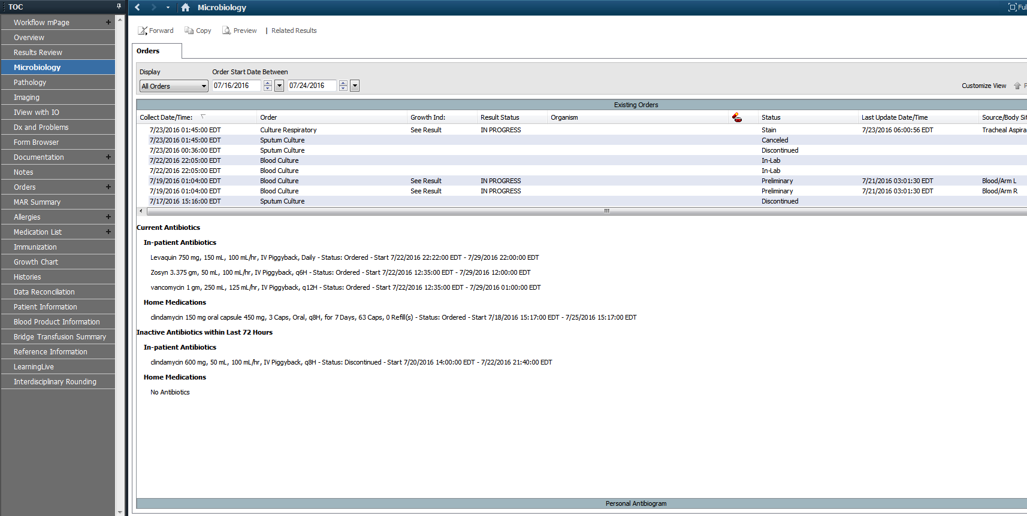
Pre-rounds
Microbiology section
Review culture results daily
Know what you are still waiting for

Slide 17
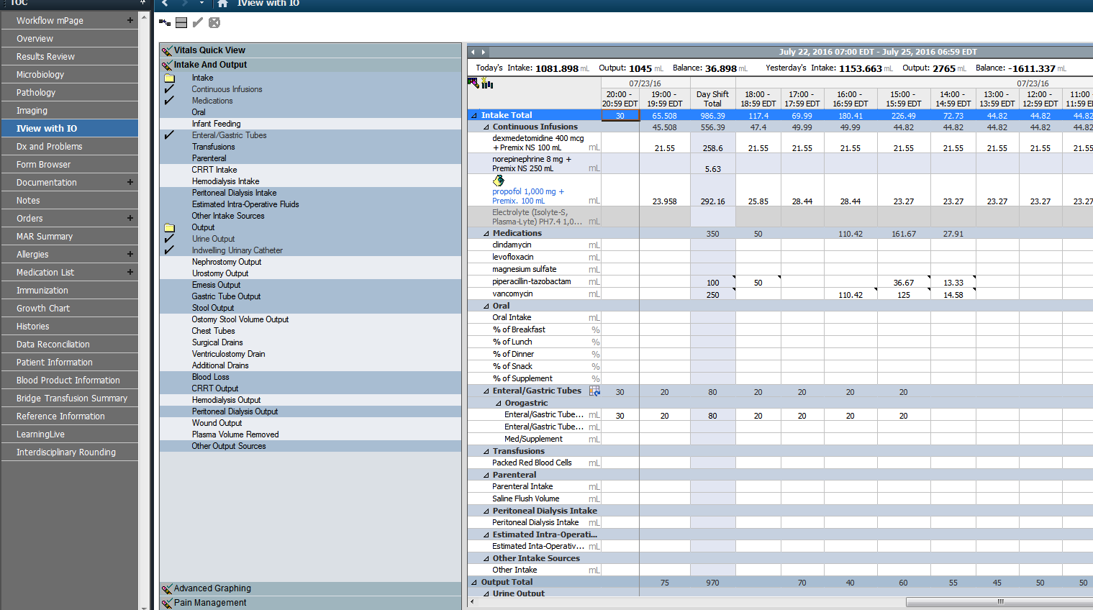
Pre-rounds
IView with I/O section
“Intake and Output” tab
Review urine output
Review Chest tube outputs
Review drain outputs

Slide 18
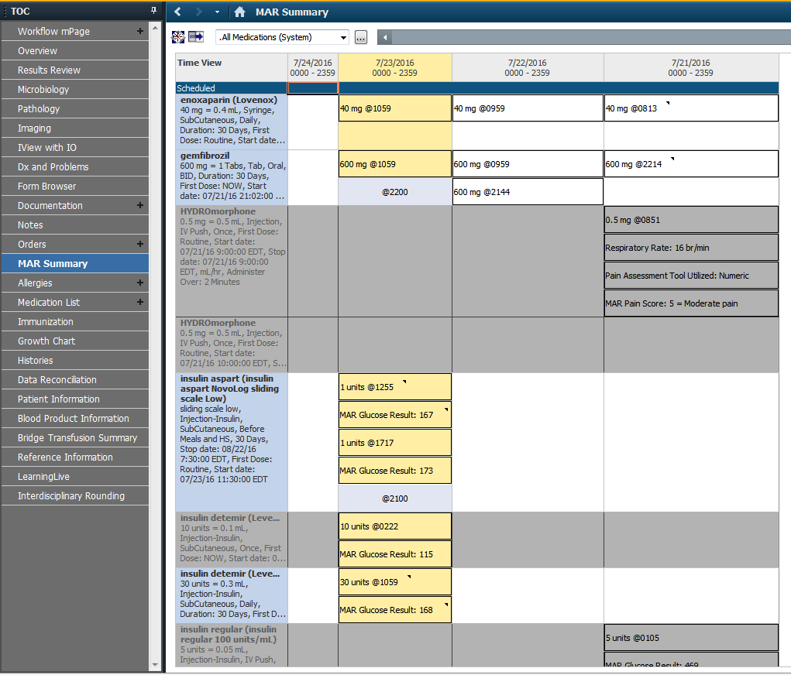
Pre-rounds
Under the MAR summary tab.
Review all the patient’s medications
Review all drips (rates and changes)
Review all PRNs (has the patient been receiving it?)

Slide 19
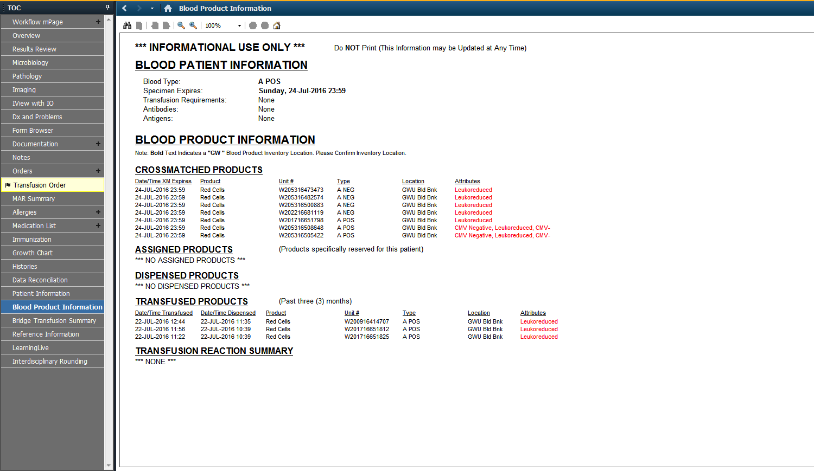
Pre-rounds
Under the “Blood Product information” section
Date type and screen expires.
Products Cross matched to the patient

Slide 20
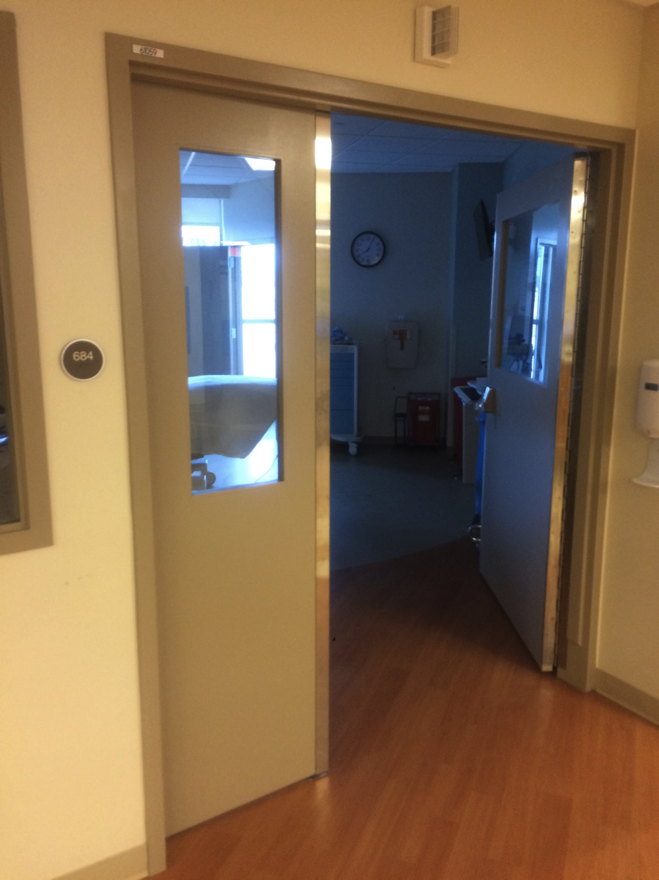
Pre-rounds: W/in the pt’s room

Slide 21
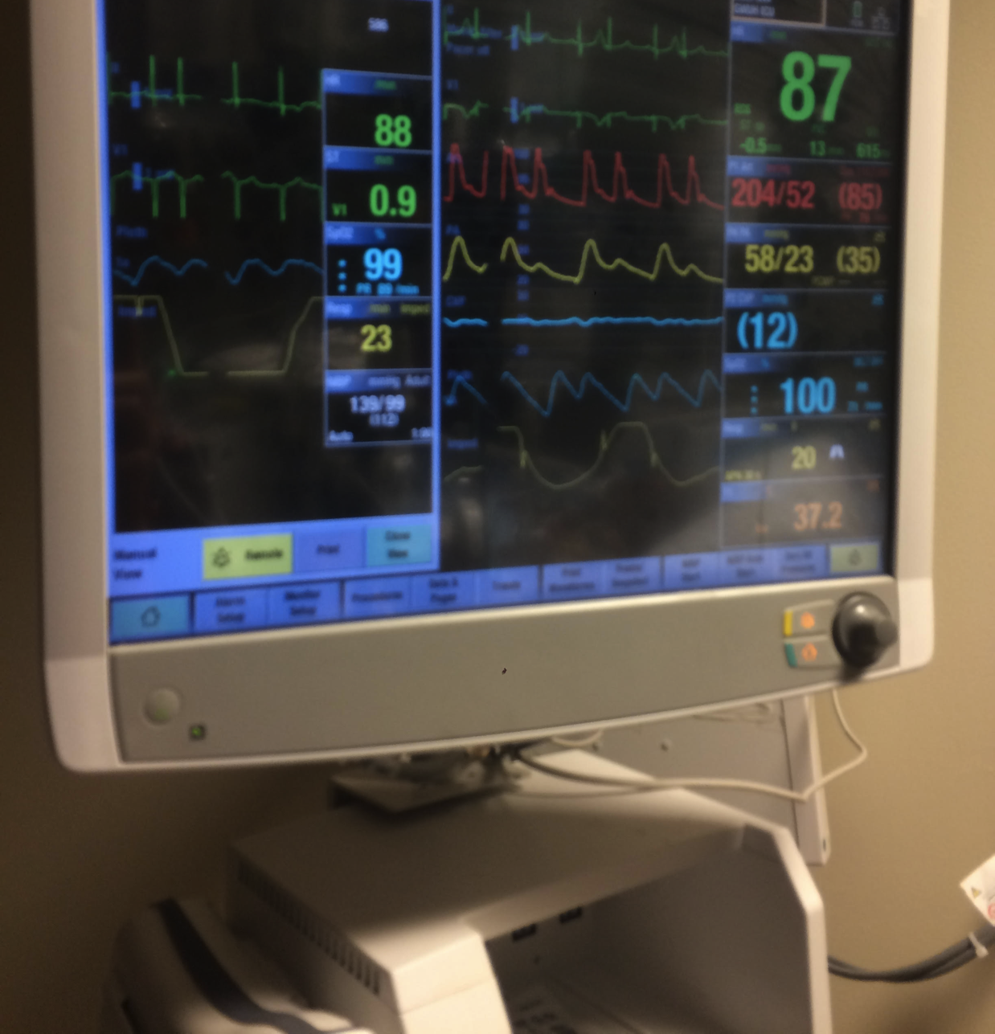
Cardiac Monitor
Telemetry
Arterial line
CVP
Pulse Ox

Slide 22
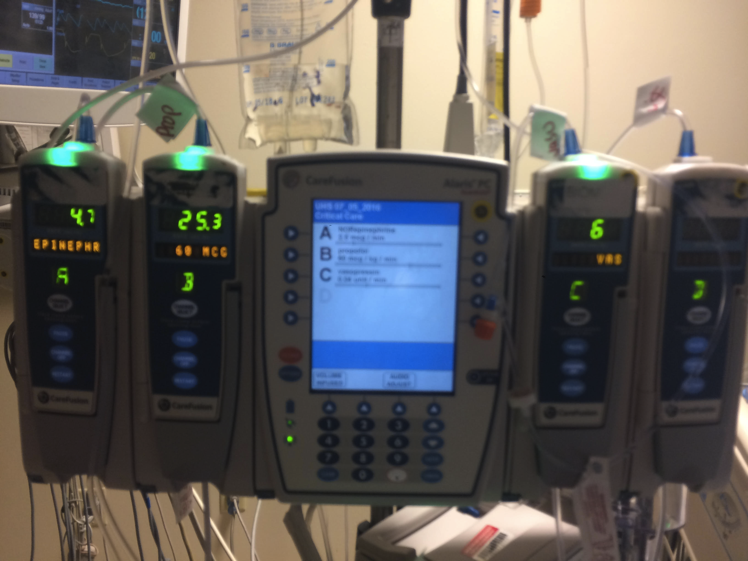
IV Pumps: medication name and rate

Slide 23
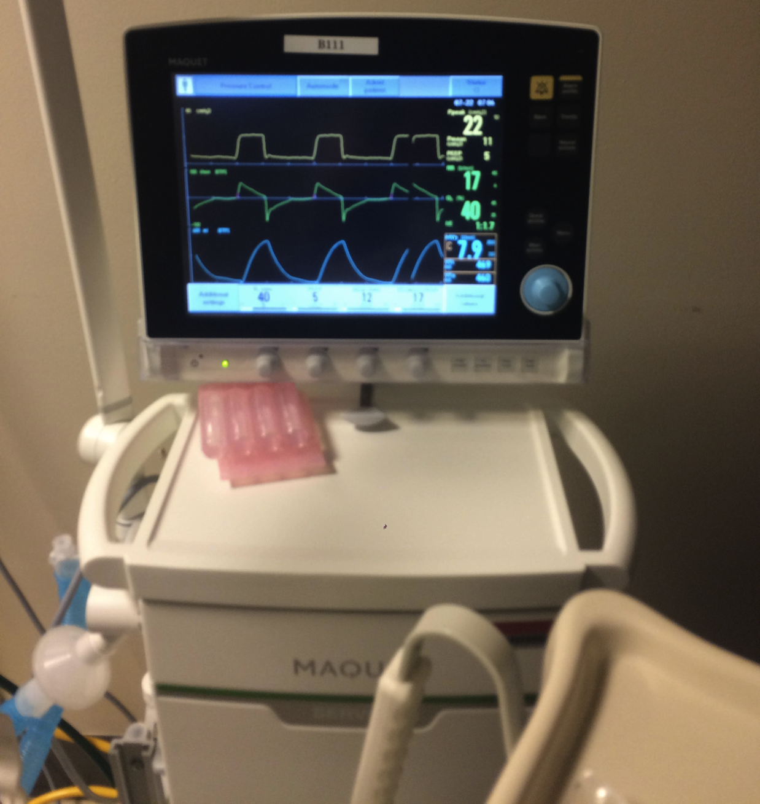
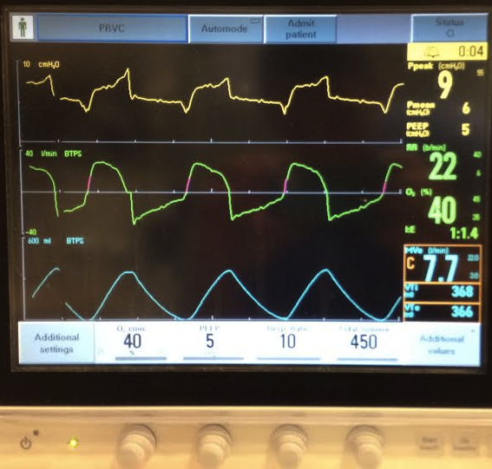
Ventilators
Mode
FiO2
PEEP
RR
Tidal volume or Pressure

Slide 24
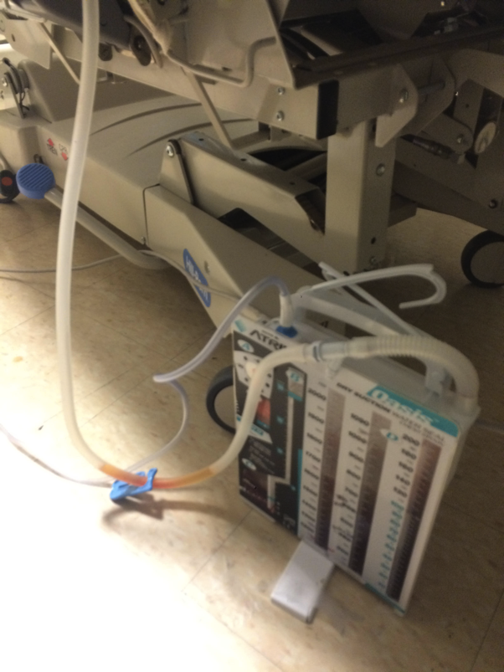
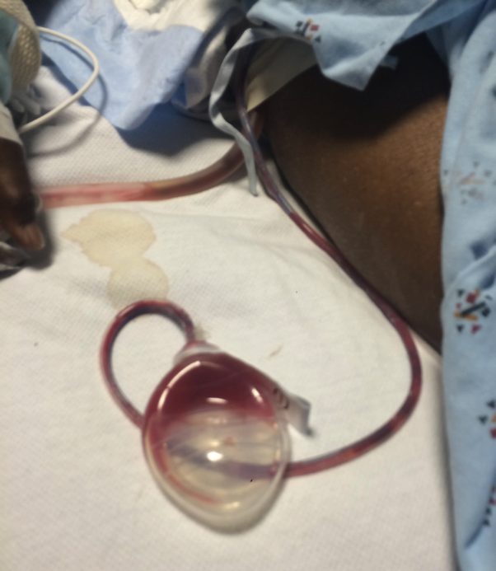
Physical Exam!
Don’t forget to get a neuro exam off sedation
Ask the nurse for help with this
Don’t forget to look at the patient’s drain and line sites
When was it placed?
Where is it?
What is coming out?
How much is coming out?
Can it come out?

Slide 25
Tips for Rounds
Try to grasp the overall picture of the patient
Why were they admitted to the ICU?
What is keeping them in the ICU?
From that, generate a plan
How are you going to get them out of the ICU?
Organize by systems: Neuro, Cardic, Pulm, GI, etc.
Don’t just present data, interpret it
Normal data usually does not need to be presented

Slide 26
Presentation of Pts
HPI (for new pts)
Reason for ICU admission (for old pts)
Overnight events
Overall assessment (1 liner about who the patient is, why they are here, and what is going on)
Plan by system:
Relevant objective data: VS, Labs, imaging, micro
Treatment/Actions

Slide 27
System: Neuro
Pain regimen
Sedation
Drips and medications
Rates and doses
RASS scoring
Bolts and EVDs

Slide 28
Neuro Tips:
Drug | MoA | Dose | Special considerations
Propofol | Short acting hypnotic | Induction: 1-2mg/kg infusion: 5-50 mcg/kg/min | Hypotension Lipid emulsion Propofol infusion syndrome
Precedex dexmedetomidine | Α2 agonist | infusion: 0.5-1.5 mcg/kg/hr | Bradycardia high fluid volume Less respiratory depression
Ketamine | NMDA receptor antagonist | Induction: 1-2mg/kg Infusion: 5-15 mg/hr | Release of endogenous catecholamines Can cause laryngospasm
Midazolam versed | benzo | Induction: 0.3mg/kg* (usually use only 2-4 mg) | Short acting Strong amnestic properties
PCA – patient controlled pain pump
AACA – Nursing controlled pain pump
Drug | MoA | Dose | Special considerations
Dilaudid Hydromorphone | Opiate | Bolus: 0.5-2.0 mg AACA: start 0.2-0.4 mg q 10-20min | Longer half life (2.3hr) Hepatic metabolism
Fentanyl | Opiate | Bolus: 25-100mcg AACA: start 25-50mcg q 10-20min | Short half life (217 min) Hepatic metabolism

Slide 29
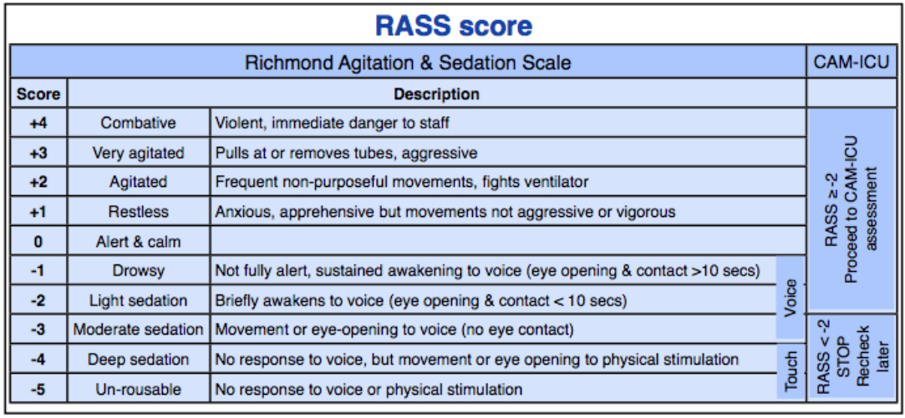
Neuro Tips:

Slide 30
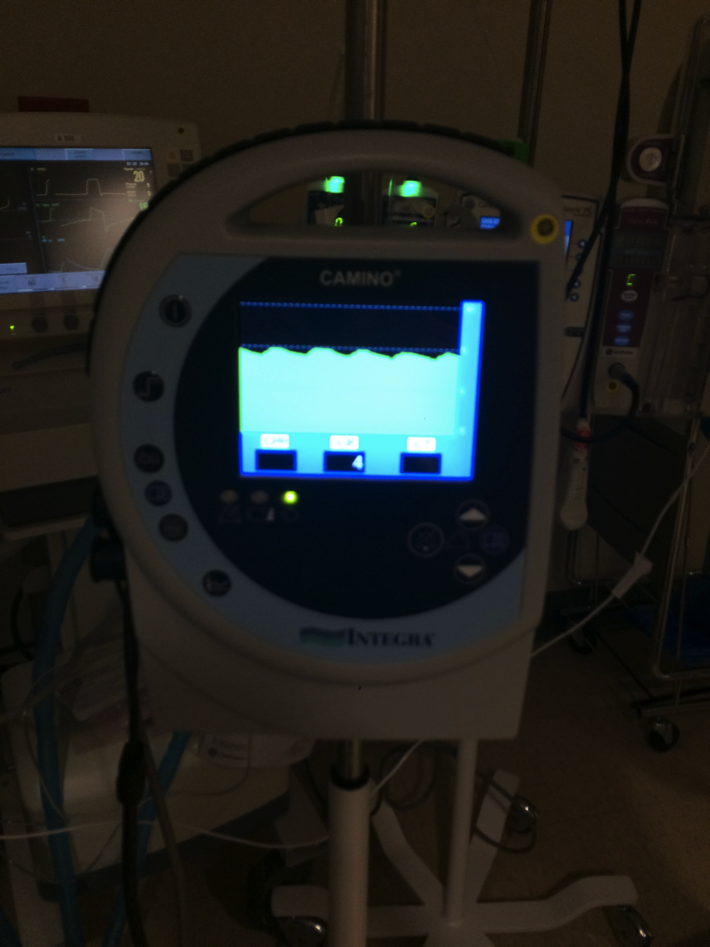
Bolts vs EVDs
Bolts:
Will only monitor ICP
Less invasive
Less skill to place
Can be placed anywhere
CANNOT be recalibrated. Zeroed at placement. Will drift after a couple days.

Slide 31
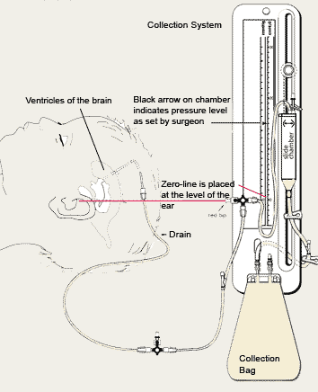
Bolts vs EVDs
EVD (extra-ventricular drain)
Monitors ICP and CSF color/quantity/quality (bloody, cloudy)
Drains CSF to normalize ICP
EVD will be set to a level, if ICP exceeds that level it will drain off CSF

Slide 32
System: Cardiovascular
FloTrack
Pressors
Ectopy
Arrythmias

Slide 33
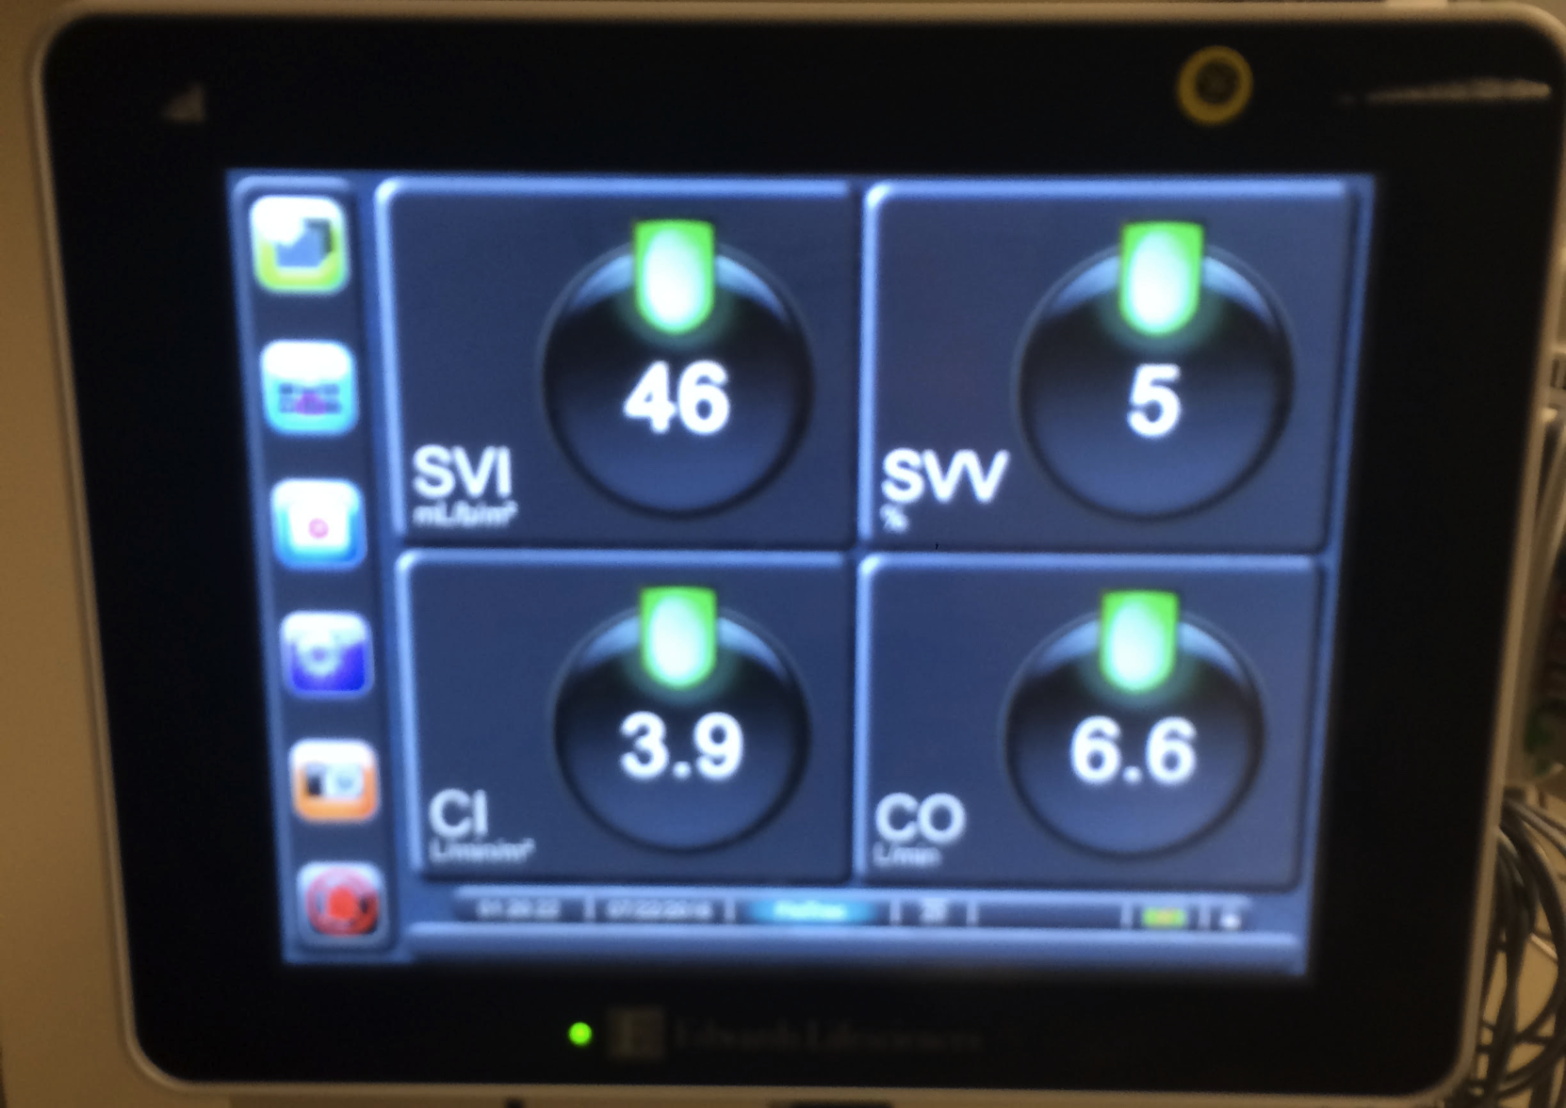
Cardiovascular Tips
FloTrack:
Requires an arterial line
Monitors CO, SV and SVV in real time
Stroke Volume Variation:
Variation in arterial pressure w/ inspiration and expiration due to changes in intra-thoracic pressure
Goal volume resuscitation of SVV of <13%
Note: arrhythmias (afib), increased PEEP, vasopressors

Slide 34
System: Respiratory
Mechanical ventilation
Non invasive ventilation: CPAP, BiPAP
Invasive ventilation: PRVC, AC, PC
High Flow NC

Slide 35
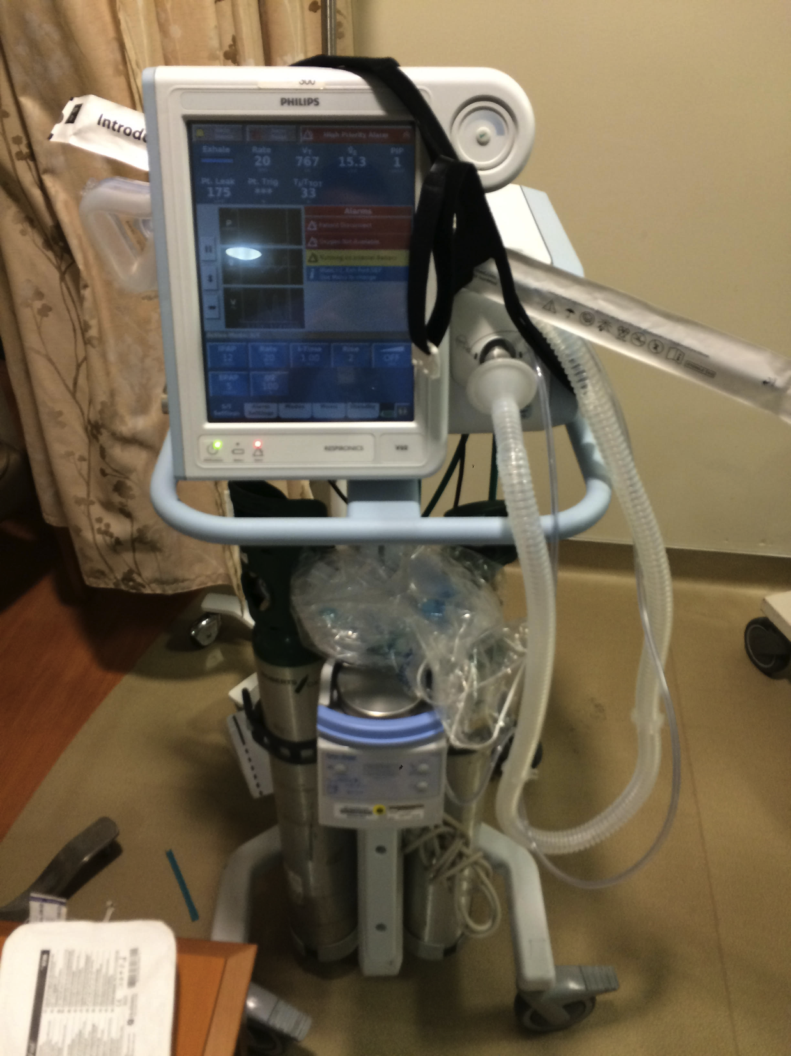
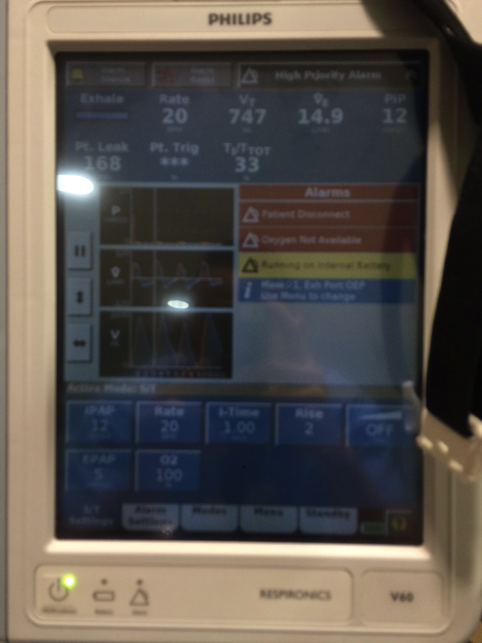
O2: FiO2, percentage of oxygen
IPAP: pressure at inspiration.
EPAP: pressure at end expiration (similar to PEEP)
BiPAP: Bilevel Positive Airway Pressure

Slide 36
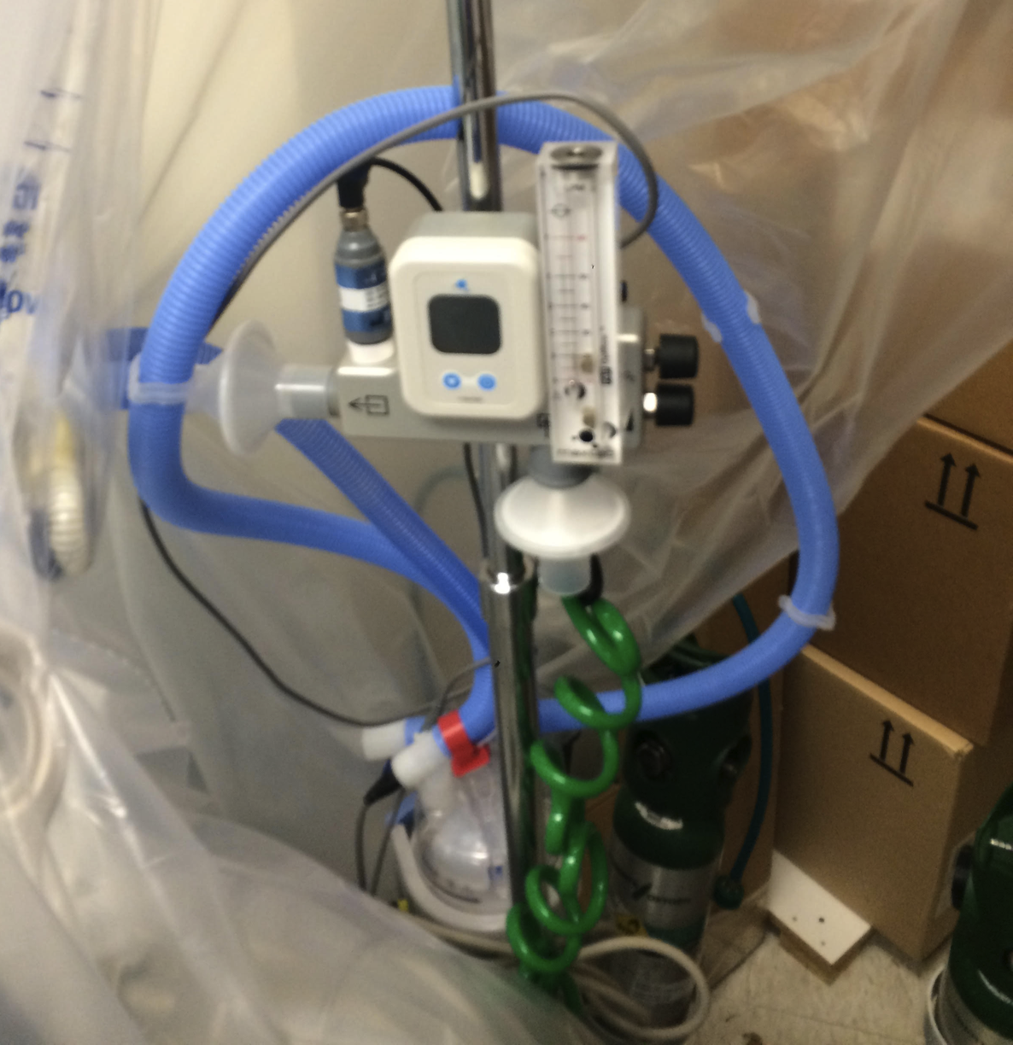
High Flow Nasal Cannula
Flow:
In liters per minute
FiO2:
Oxygen percentage

Slide 37
System: GI
Nutrition
GI prophylaxis when indicated
Limit NPO whenever possible
Tube feeding
Early is better
Goal is based on ml/day, supplied at a rate of ml/hr
If turned off for any reason, you can make up time by increasing the rate
Nutritional goals based on nutritional consult
The average person needs ~25 kcal/kg/day
Cal/ml varies by formula
Bowel regimen

Slide 38
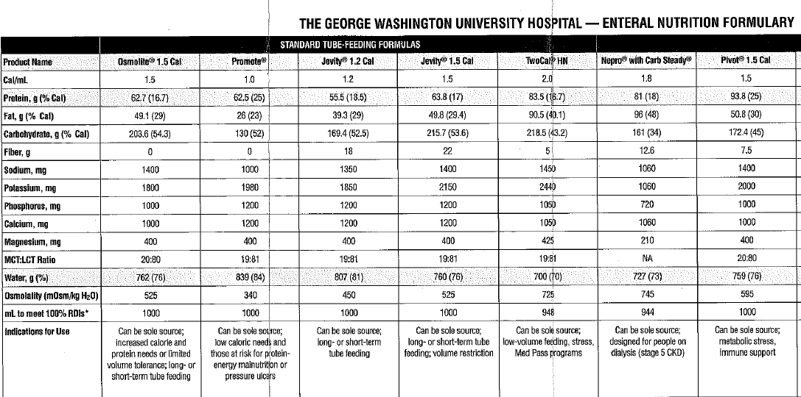
GI Tips
The average person needs ~25 kcal/kg/day.

Slide 39
Renal
AKI - need to know their baseline
Urine output
Renal replacement protocol (must be eligible)
Hypernatremia, free water deficit
Need for dialysis or CVVH

Slide 40
Renal Tips
Indications for Hemodialysis: AEIOU
Acidosis, electrolyte abnormalities (K), ingestions, overload, uremia
CRRT: continuous renal replacement therapy
Used in critically ill patients who would not tolerate HD
Slower and more labor intensive but avoids hypotension

Slide 41
Heme
VTE Ppx
SCDs
Lovenox
30mg subQ BID
Preferred, especially in trauma patients
Heparin
5000 units subQ TID
Used in renal failure patients (Cr clearance < 30ml/min)
Used in pts with high risk of return to surgery
Transfusions
RBC, platelets, FFP, cryoprecipitate
HIT: heparin induced thrombocytopenia
5 to 10 days after heparin admin, plt counts decline 50% or more

Slide 42
Heme Tips
Transfusions:
“Product order” - tells the blood bank that you want blood products for your patient.
If you only order this, it will hold products for future use.
Pts with active bleeding or expected blood loss should have RBCs on hold
“Transfusion order” - tells the nurse to request the blood and then give it
If you do not complete this order, your patient will not be transfused
At GW, platelets are only single donor apheresis platelets
Do not choose six pack pooled platelets.

Slide 43
Heme Tips

Slide 44
System: ID
Fever curve
Antibiotics
Vancomycin and meropenum are a good start but need to be narrowed as soon as possible
All abx should be ordered with a stop date
Micro
Check speciation and susceptibilities daily

Slide 45
ID Tips
Vancomycin
Usual starting dosing 15mg/kg
dosed by trough, goal trough 15-20 mg/L
In pts with normal renal function, trough is checked 30 minutes before the 4th dose
In pts with renal dysfunction, vancomycin is dosed by level
Vancomycin is given and 12-24 hrs later a level is checked
If the level is low, vanc is re-dosed, level check again.

Slide 46
ID Tips
Foleys
d/c as soon as possible
can be colonized without being infected, unnecessary culturing will lead to false positive CAUTIs.
Send a UA and check result
If UA is positive -> change the foley and send a 2nd UA
If 2nd UA is positive -> send a culture

Slide 47
System: Endo
Glycemic control
glucose <180mg/dL is recommended
Insulin regimen
Aspart – short acting
low, intermediate, or high sliding scale for correction
Q6H vs QAC, HS
Levemir – long acting; dose once or twice a day for better baseline control
Dosed by adding up all the SSI used over 24 hrs and order half of that
If NPO, long acting insulin should be cut in half

